Slide 1

Audio Aplifier with
LM386
AUDIO AMPLIFIER PROJECT
01

Slide 2


Components for Project :
1) SPEAKER 4-OHM 5W
2) 10-ohm resistor
3) LM 386-n1 IC
4) wires
5) pot resistor 10 k ohm
6) 470 uf capacitor
7) 33 uf capacitor
8) jack 3.5mm
9) capacitor 10uf
10) capacitor 47 nano farad
11) capacitor 100 nano farad
12) DC source 5v
02

Slide 3

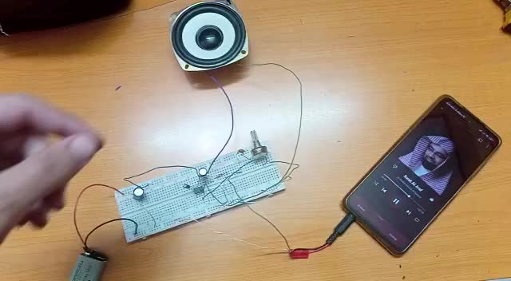
Video for circuit when it work :
03

Slide 4
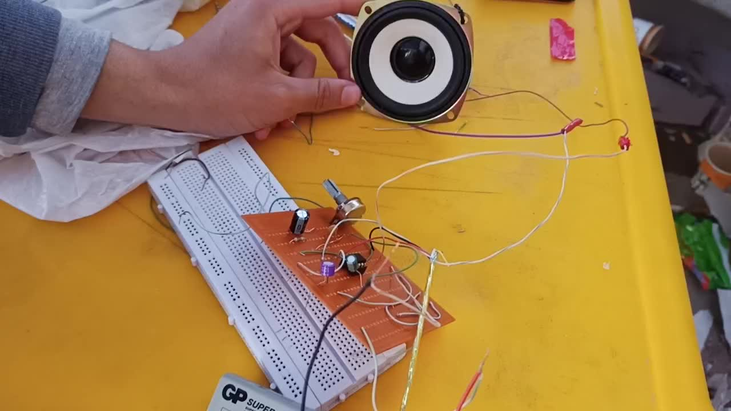
VIDEO FOR CIRCUIT WHEN IT WORK :
04

Slide 5
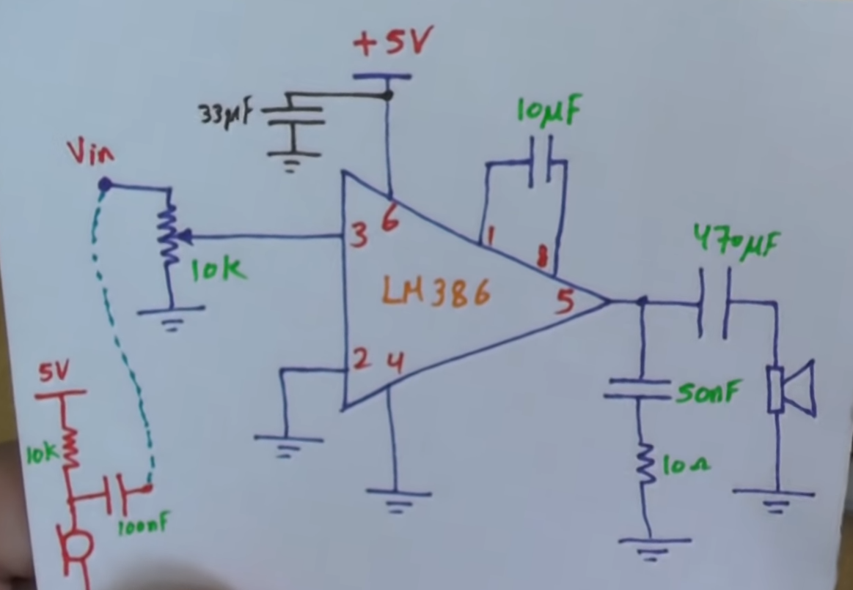

Circuit of the Audio Aplifier:
05

Slide 6
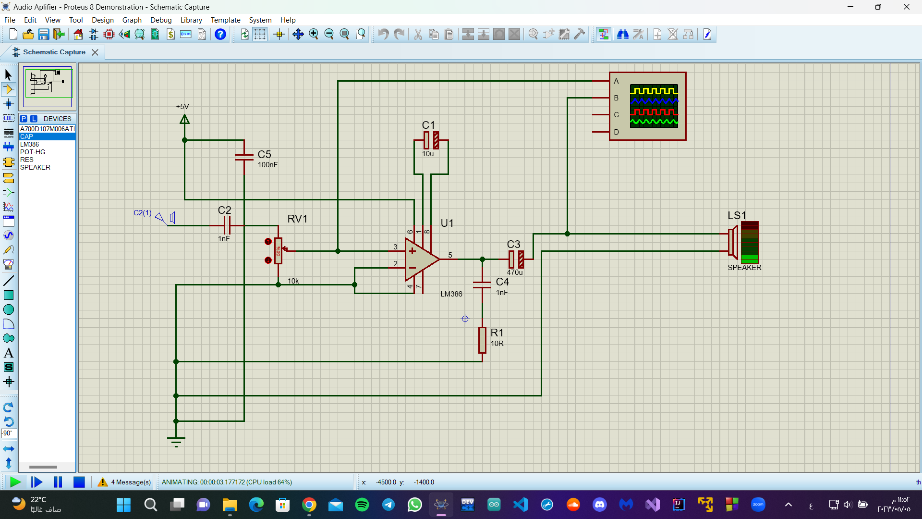
Circuit of the Audio Aplifier:
06

Slide 7
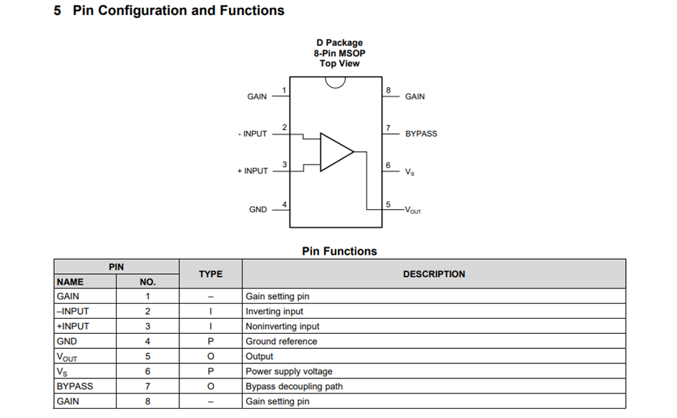
07
IC LM386

Slide 8
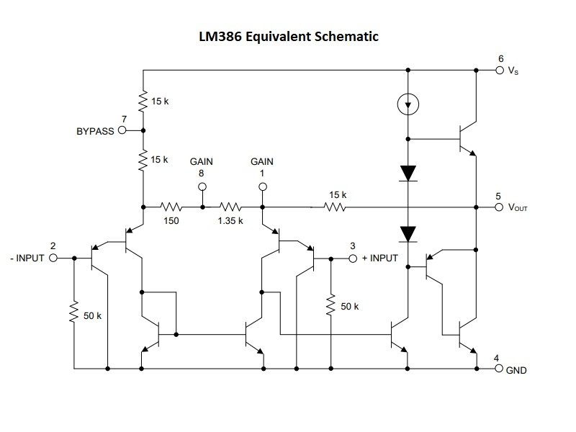
08

Slide 9

EXPLAIN THE CIRCUIT:
WHEN WE CONNECT AN AUDIO JACK AND PLAYING AUDIO, WE SEE THE AUDIO IS INCREASED
WE CAN CONTROL THE AUDIO LEVEL USING POT RESISTOR
- WHEN WE CONNECT THE OSCILLOSCOPE , WE SEE THE OUTPUT WAVE IS INCREASED
09

Slide 10
How the audio amplifier Circuit works ?
1) IC LM386 CONSISTS OF 8 PINS
2) IC LM386 CONSISTS OF A NETWORK OF TRANSISTORS, WHICH IN TURN AMPLIFY THE INPUT SIGNAL FROM INPUT NO. 3 TO OUTPUT NO. 5
3) A 10 MICROFARAD CAPACITOR IS PLACED ON TERMINALS IC 1 AND 8 TO AMPLIFY THE SOUND 200 TIMES
4) WITHOUT 10UF CAPACITOR SOUND IS AMPLIFYING ONLY 20 TIMES.
10

Slide 11

5) 100 NANO FARAD CAPACITOR IS USING FOR FILTERING THE INPUT SIGNAL FROM NOISE.
6) WHEN WE READ THE DATA SHEET, WE WILL KNOW WHY WE CHOSEN THESE VALUES.
7) PIN NO 2 IS A -VE INPUT PIN AND PIN NO 3 IS A +VE INPUT PIN.
8) PIN NO 5 IS OUTPUT PIN.
9) PIN NO 6 IS A SUPPLYING PIN.
09

Slide 12
10) PIN NO 4 IS CONNECTED TO GROUND.
11) 33UF CAPACITOR IS USING FOR FILTERING THE SOUND.
12)50NF CAPACITOR AND 10R RESISTOR USING TO DAMPEN THE VIBRATIONS
13)470UF CAPACITOR USED FOR FILTERING THE OUTPUT SIGNAL.
12

Slide 13

عمل الطلاب:
- على عبدالمنعم على ابراهيم
- احمد زكريا عبدالعال يوسف
- رحمه احمد يوسف امين
- ايثار عدنان ابراهيم البليدي
- اسراء مجدي محمد نجيب
13

